Slide 1
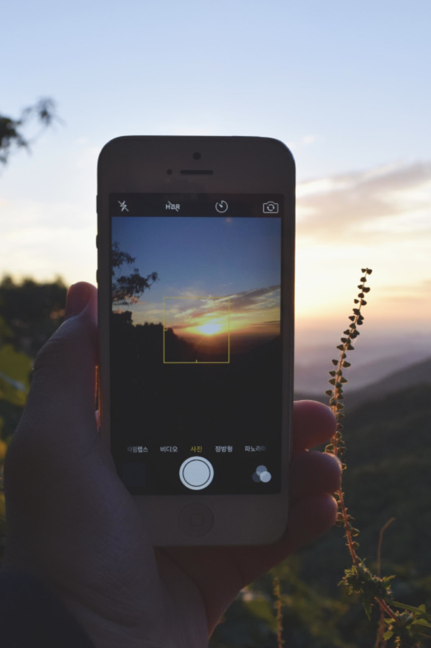

Elevate Apple Mobile Product Marketing
By
Surya Nandamuri

Slide 2
Overview
Apple's iPhone has stood as a formidable force, securing its position as the most popular smartphone in the U.S with a brand value of $880.46 billion USD.
In the fiscal year 2023, Apple’s revenue soared to $383.3 billion USD, solidifying its position as the most valuable brand globally.
The iPhone remains Apple’s crowning achievement. Its success propelled the company to create a unique ecosystem encompassing hardware, software, and services.
The Apple's Crown Jewel commands a market share of almost 50% for most part within the last decade
Its strong brand, loyal customer base, and robust financial resources position the company well for sustained success
Despite its dominance, Apple faces stiff competition from Android manufacturers like Samsung and Xiaomi, particularly in emerging markets.
Some users may be experiencing innovation fatigue, requiring Apple to continuously introduce compelling new features to maintain interest.
Apple is expected to play a significant role in the development and adoption of AR technology, potentially revolutionizing mobile experiences.

Slide 3
Importance of Mobile Product Marketing
1
Customer Engagement
Active engagement with customers is a key metric for marketing effectiveness which increases potential customers.
Targeted Messaging
2
Highlighting the user experience and how their products enhance people's lives.
3
Cost Effective
Mobile marketing can be more cost effective than traditional marketing methods.
Competitive Landscape
4
The mobile device market is highly competitive, with Android holding a larger global market share.
5
Build Brand Loyalty
Cultivate stronger relationships with its customers and encourage them to become loyal advocates for the brand.

Slide 4
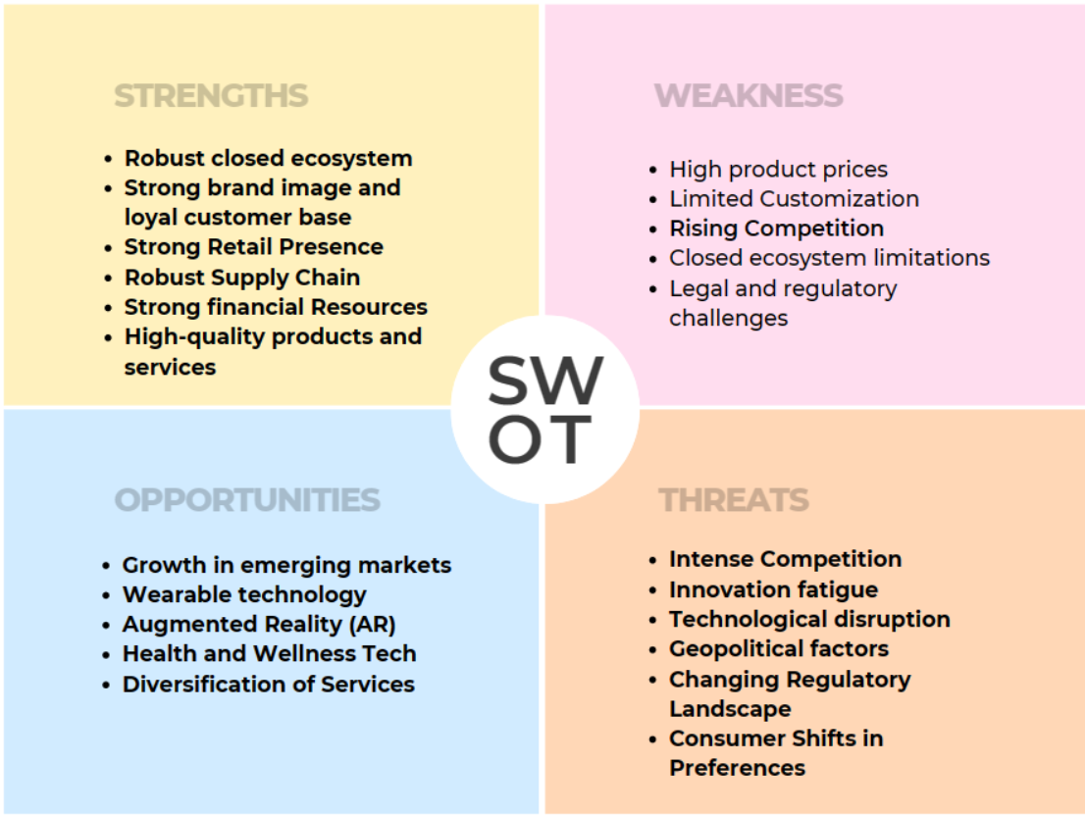
SWOT Analysis

Slide 5
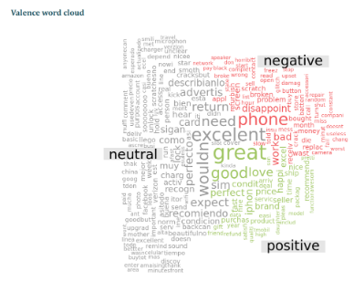
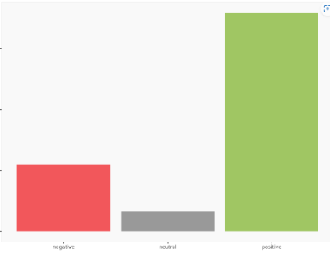
Apple Reviews E-Commerce
Posts count
Relative posts count
Total
4 999
100%
negative
1 092
22%
neutral
325
7%
positive
3 582
72%

Slide 6
Positive Dominance (72%):
Indicates a generally favorable sentiment among the audience.
Moderate Negativity (22%):
Negative sentiments are present but are notably lower than positive sentiments.
Limited Neutral Content (7%):
Suggests that opinions are often polarized towards positive or negative viewpoints.
Strategy
Strategic approach to reinforce positive perceptions and reinforce positive sentiments.
Mitigate potential issues or improve areas receiving criticism and raising negative sentiments.
Valuable insights for ongoing reputation management and strategic decision-making with continuous monitoring

Slide 7
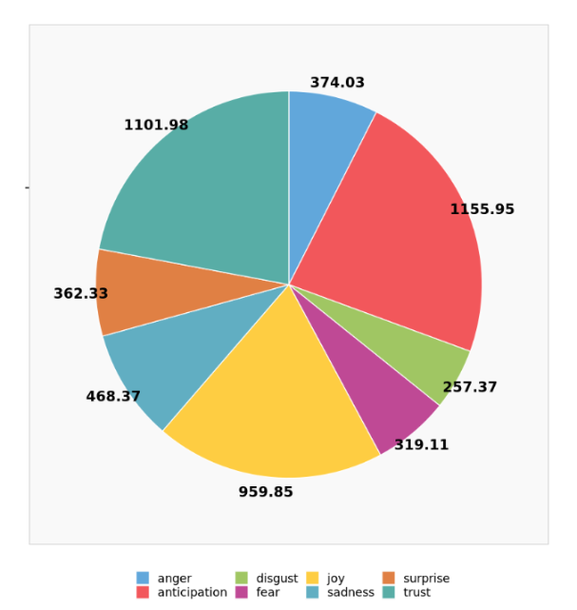
Emotional Analysis of Apple
Emotion
Posts count
Relative posts count
Total
4 999.00
100%
anger
374.03
7%
anticipation
1 155.95
23%
disgust
257.37
5%
fear
319.11
6%
joy
959.85
19%
sadness
468.37
9%
surprise
362.33
7%
trust
1 101.98
22%

Slide 8
Interpretation
Anticipation & Trust Dominance (45%): Strong positive expectations and trust.
Joyful Sentiments (19%):Users expressing joy and positivity.
Mixed Emotions (22%): Presence of anger, disgust, fear, and sadness suggests a nuanced sentiment landscape.
Considerations for Action:
Reinforce Positive Experiences: Leverage anticipation and trust by highlighting positive aspects.
Address Concerns: Focus on areas associated with negative emotions to enhance overall satisfaction.
Continuous Monitoring: Ongoing monitoring of emotions for adaptive strategies.
Conclusion
The sentiment analysis indicates a predominantly positive emotional landscape.
Main focus on anticipation, trust, and joy.
Addressing concerns related to negative emotions will contribute to a holistic and positive user experience with Apple mobile products.

Slide 9
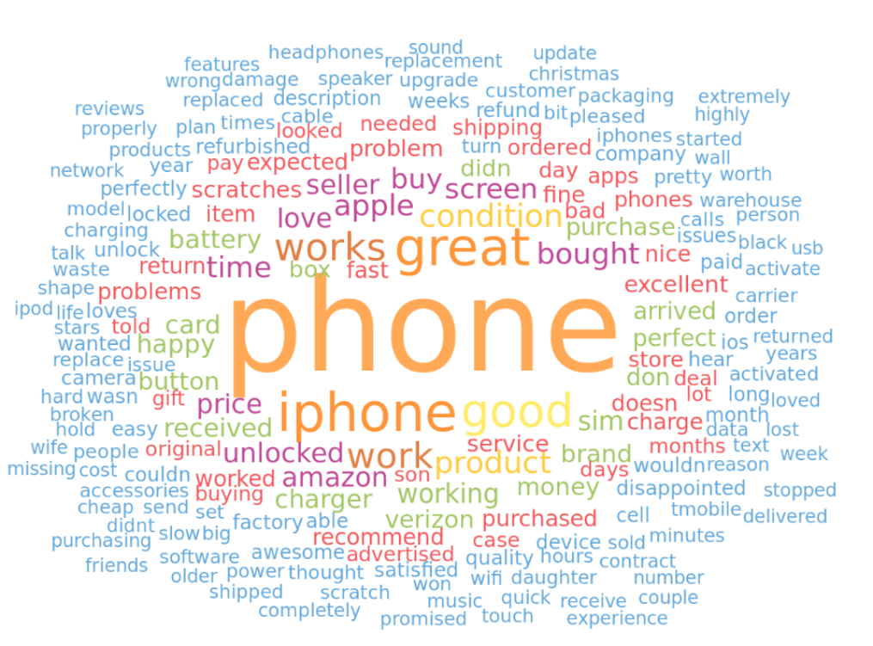
Use of Words Describing Apple Products

Slide 10

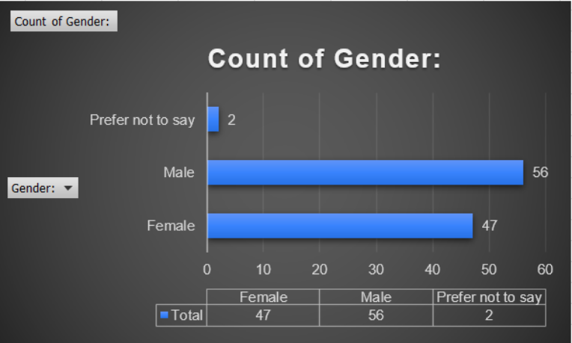
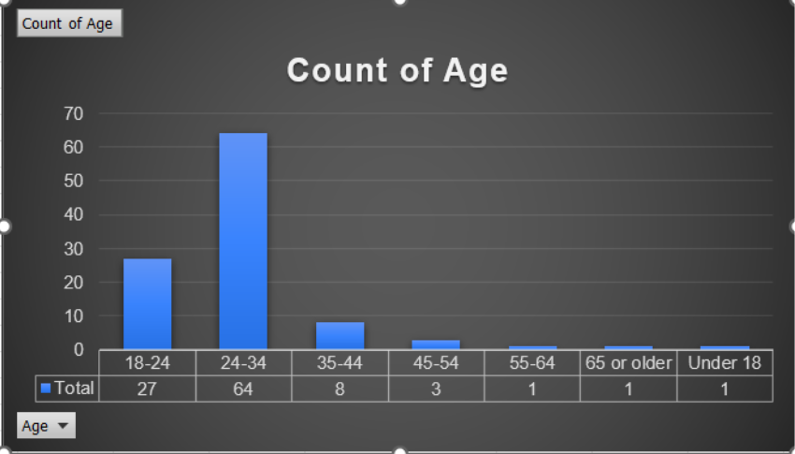
Demographic Insights

Slide 11
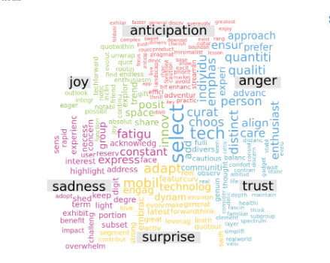
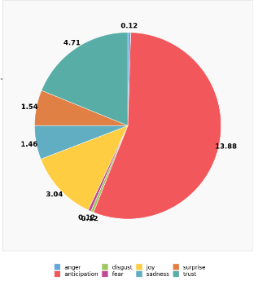
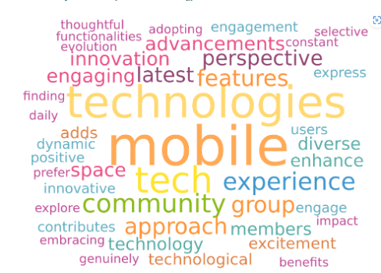
Sentiment Analysis from Interview
Engagement with Mobile

Slide 12
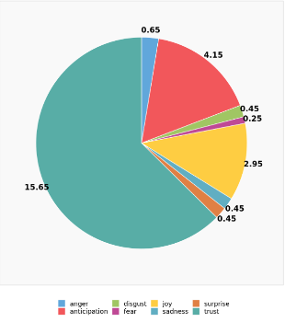
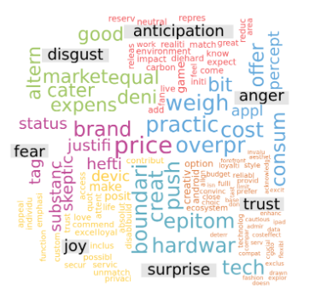
Brand Perception

Slide 13
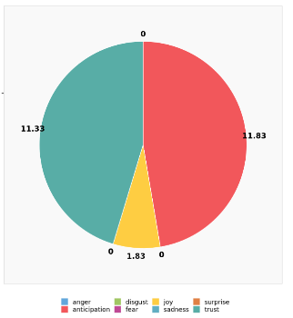
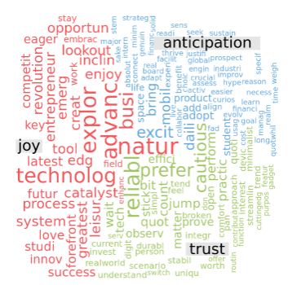
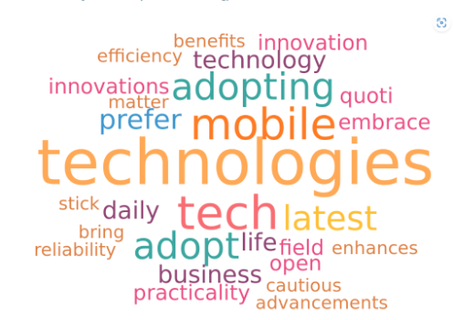
Adoption to New Tech

Slide 14
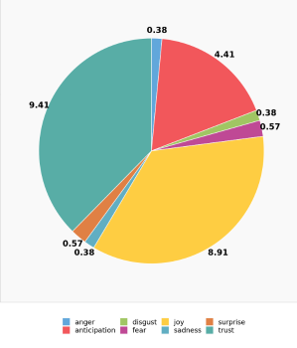
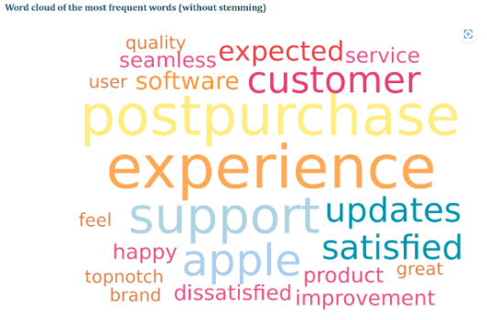
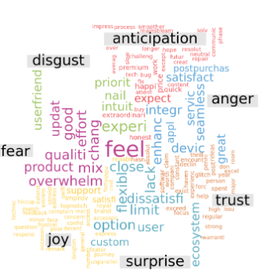
Brand Satisfaction

Slide 15
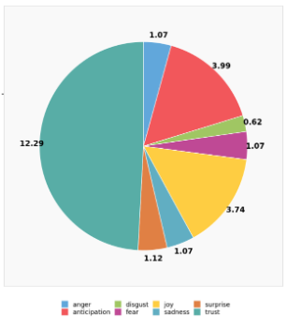
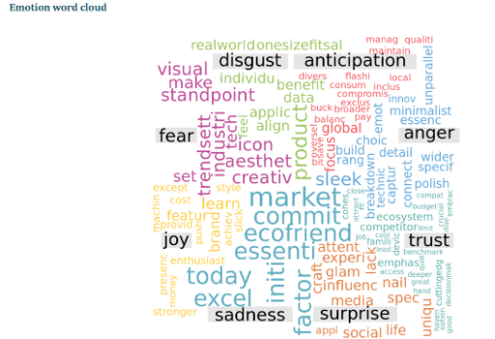
Market Perception

Slide 16
Segmentation
Interest
Population
Segment 1
Segment 2
Segment 3
SmartPhone Interest
3.26
5
4.05
1.46
SmartwatchesInterest
2.84
4.13
2.48
2.44
Earbuds Interest
2.76
5
1.88
2.32
Accessories Interest
2.31
3.25
2.25
1.83
Brand Response
3.6
3.83
3.63
3.44
Brand Recommendation
4.01
4.33
4.25
3.59
Adoption
3.84
4.33
4.15
3.24
Purchase Satisfaction
3.98
4.17
4.2
3.66

Slide 17
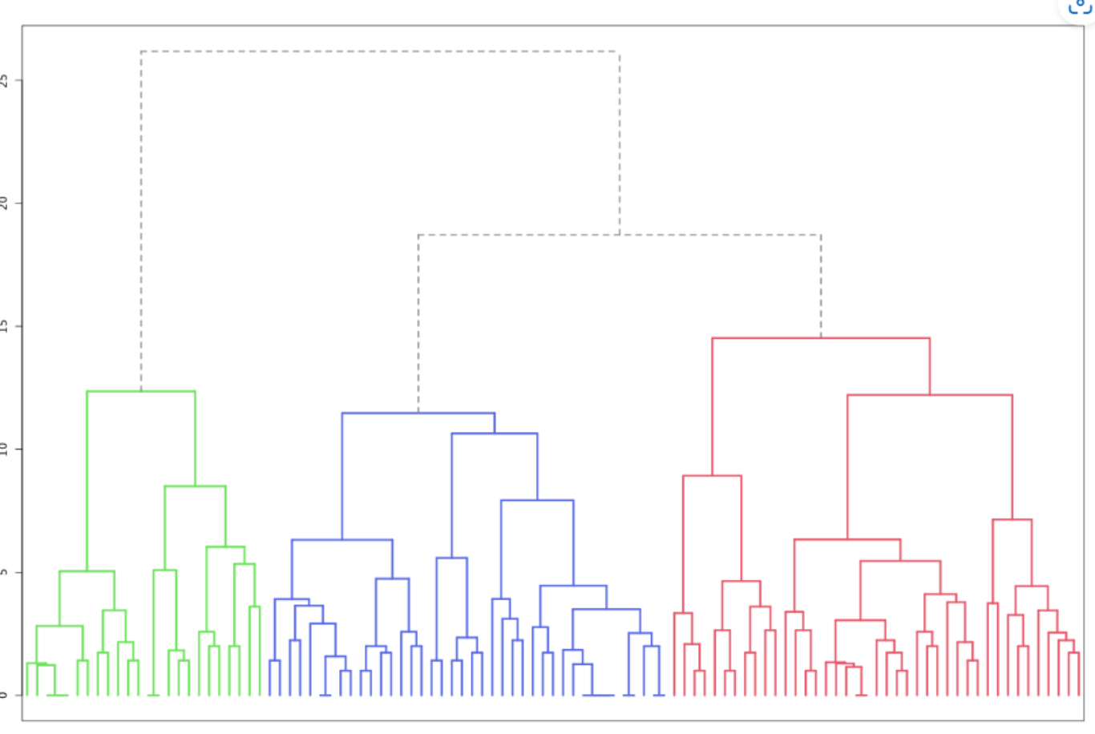

Slide 18
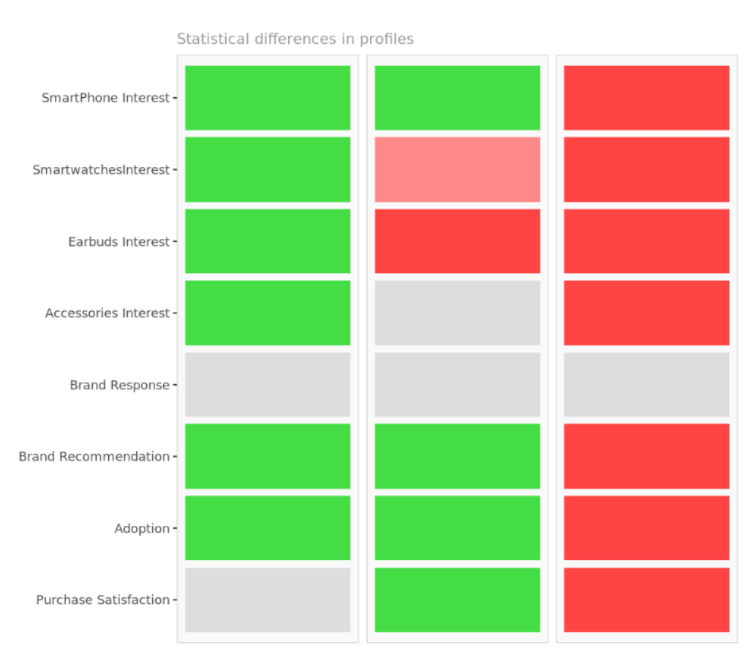

Slide 19
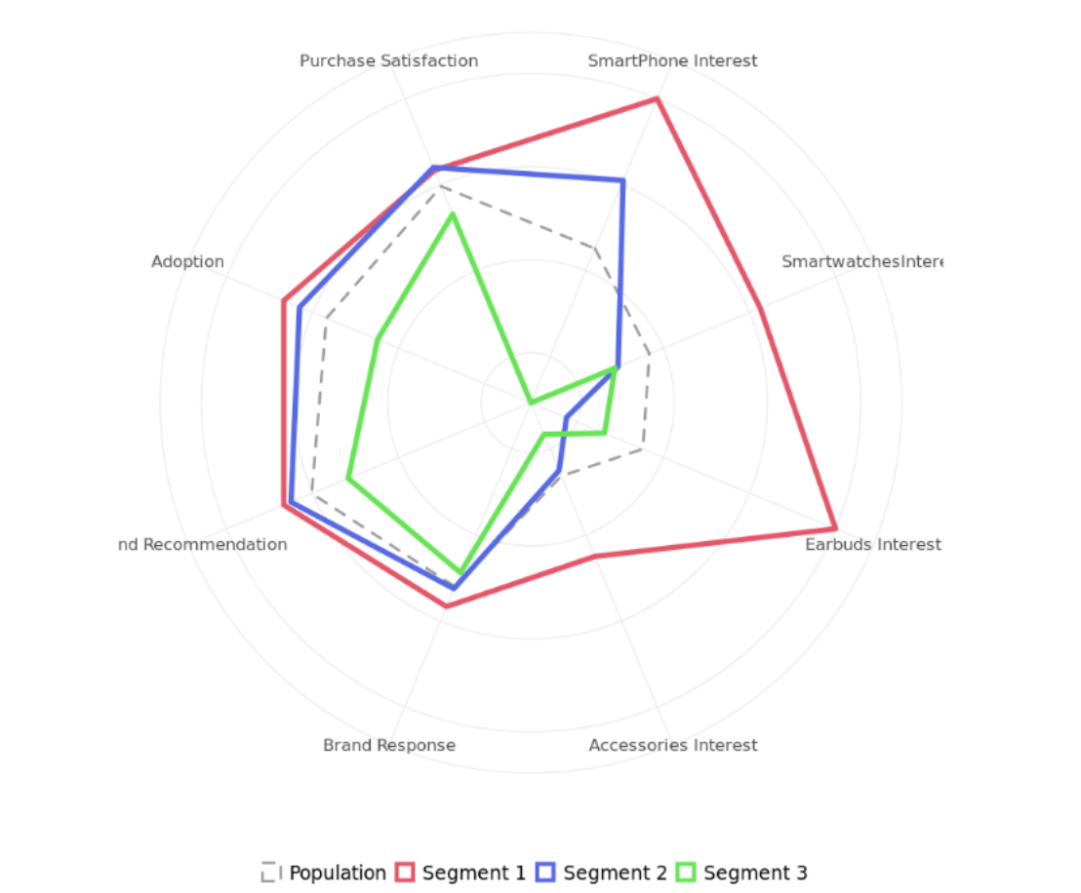

Slide 20
Segments Description
Segment 1: Tech Enthusiasts & Advocates
Highly enthusiastic and tech-savvy individuals
Express keen interest in smartphones but also exhibit a strong affinity for wearable technology and wireless audio accessories.
This segment not only appreciates the brand but actively advocates for it, making them influential in spreading positive sentiments.
Mostly Male Dominated, with Higher Educational Background
Segment 2: Casual Users
Represents a group of consumers who are generally interested in smartphones and related accessories.
Showing satisfaction and a positive brand perception.
While not as fervently enthusiastic as Segment 1, they have a balanced and positive approach to their mobile technology preferences.
Mostly Graduate Students and age group of 24-34
Segment 3: Price-Sensitive Users
Larger group of consumers who are more price-sensitive,
Shows lower interest in smartphones and accessories.
Still exhibit positive brand sentiments and satisfaction but may be more cautious in adopting new products.
Likely influenced by budget considerations.
People with lesser educational Background

Slide 21
Description
Segment 1
Segment 2
Segment 3
Gender: = Female
0.333
0.475
0.488
Gender: = Male
0.667
0.5
0.488
`
0.292
0.325
0.171
Age = 24-34
0.542
0.675
0.585
Age = 35-44
0.125
0
0.122
Educational Background = Master s degree
0.625
0.75
0.463
Educational Background = Bachelor s degree
0.25
0.25
0.39

Slide 22
Short Term Strategies
Segment 1: Tech Enthusiasts & Advocates
Segment 2: Casual Users
Segment 3: Price-Sensitive Users
Implement short-term promotions or bundled offers to drive immediate interest and purchases.
Promoting rebates, or cashback options to stimulate immediate interest and purchases
Offer exclusive discounts and drive the engagements.
Leveraging influencers and user-generated content
Promoting Interactive Content which explains more about the product
Implement referral programs to incentivize existing users to recommend the brand to others
Provide early access to new releases and opportunities to interact with the brand.
Share customer testimonials and success stories to build trust and reinforce positive brand perception
Introduce special promotions tied to seasons or events to create urgency and prompt immediate engagement

Slide 23
Long Term Strategies
Segment 1: Tech Enthusiasts & Advocates
Segment 2: Casual Users
Segment 3: Price-Sensitive Users
Expand the product line with a variety of smartphones, wearables, and accessories to cater to different preferences within the segment.
Introduce budget-friendly product lines or options without compromising essential features.
Early releases, or limited-edition devices to reward and engage this highly enthusiastic segment.
Implement flexible finance and upgrade plans to ease financial constraints and encourage regular product updates.
Leverage satisfied customers as brand ambassadors to amplify positive word-of-mouth.
Invest in customer support services, ensuring that assistance is readily available.
Implement loyalty programs with exclusive perks.
Emphasize value propositions, emphasizing durability, longevity, and cost-effectiveness in marketing materials.
Develop educational content to inform users about the full range of products and their features.
Showcase cutting-edge technologies to keep excited about the brand's continuous innovation.
Foster a sense of community among users with forums, social media groups.

Slide 24

Conclusion
Apple's iPhone dominance in the U.S. market.
Proposed Strategies
Strong brand, loyal base, facing competition and innovation fatigue.
For Tech Enthusiasts (S1), the emphasis is on discounts, influencer collaboration, and early access.
Recogniziimportance of mobile product marketing
Casual Users (S2) benefit from promotions, interactive content, and testimonials.
Key focuses include enhancing customer engagement for effective expansion and fostering brand loyalty through strengthened relationships and advocacy.
Price-Sensitive Users (S3) are targeted with promotions, referral programs, and seasonal deals.
Long Term Strategies
Summary
Long-term strategies envision exclusive releases and loyalty programs for Tech Enthusiasts (S1).
Apple's mobile product marketing strategy is a dynamic blend of short-term initiatives and long-term approaches.
Casual Users (S2) are engaged through product diversification, robust customer support, educational initiatives, and community building.
Caters to individual consumer segments.
Focused on sustained innovation, brand loyalty, and community development."
Price-Sensitive Users (S3) are targeted with budget-friendly products, flexible finance plans, and value-driven marketing.

Slide 25
Sources
https://www.counterpointresearch.com/insights/apple-iphone-market-share-quarter/
https://www.statista.com/topics/847/apple/
https://www.businessofapps.com/data/apple-statistics/

